Slide 1
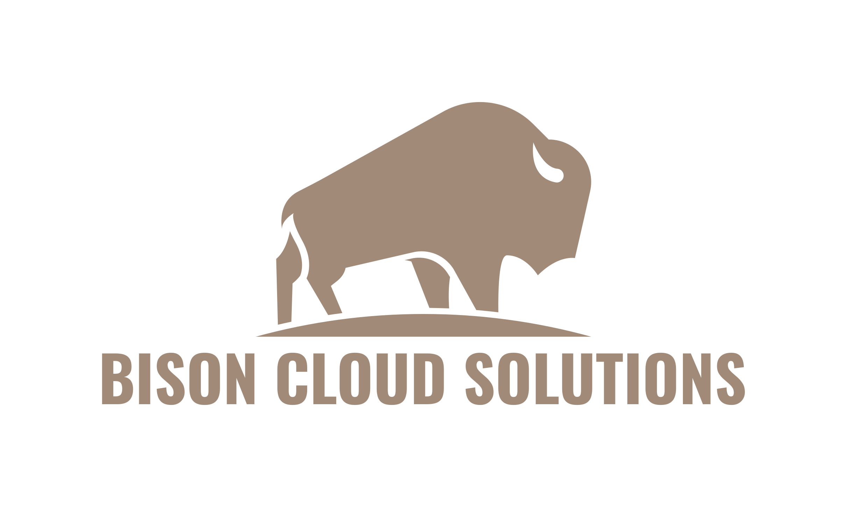
Cloud Security Awareness

Slide 2

Agenda
Introduction
Ephemeral Environments
Cloud Native Tools
Financial Security Issues
Secure Configuration Management

Slide 3
Introduction
Presenter: Jacob Charles
Owner of Bison Cloud Solutions
Other Affiliations: City County CISO, KBR
Background
Value-add managed service provider, solution architecture and security engineering
Cloud Consulting & Engineering Services
FedRAMP, SOC2, and cyber risk insurance compliance
Presentation: https://github.com/bisoncloudsolutions/cloud-security-awareness

Slide 4
Ephemeral Environments
Resources that last less than 14 days (rule of thumb)
Containers and virtual machines that scale in and out of existence
Serverless
Presents numerous security challenges
Licensing models on traditional tool sets
Logging & digital forensics
Threat traceability

Slide 5
Cloud Native Tools
Use cloud aware or cloud native security tools
Traditional on-premise tools may not have visibility into cloud services such as serverless functions
IP based tools may not properly identify resources, especially in ephemeral environments
Avoid the "Moving Target" scenario; this scenario is when tools identify issues but not the source
Example: an ephemeral image with a security vulnerability

Slide 6
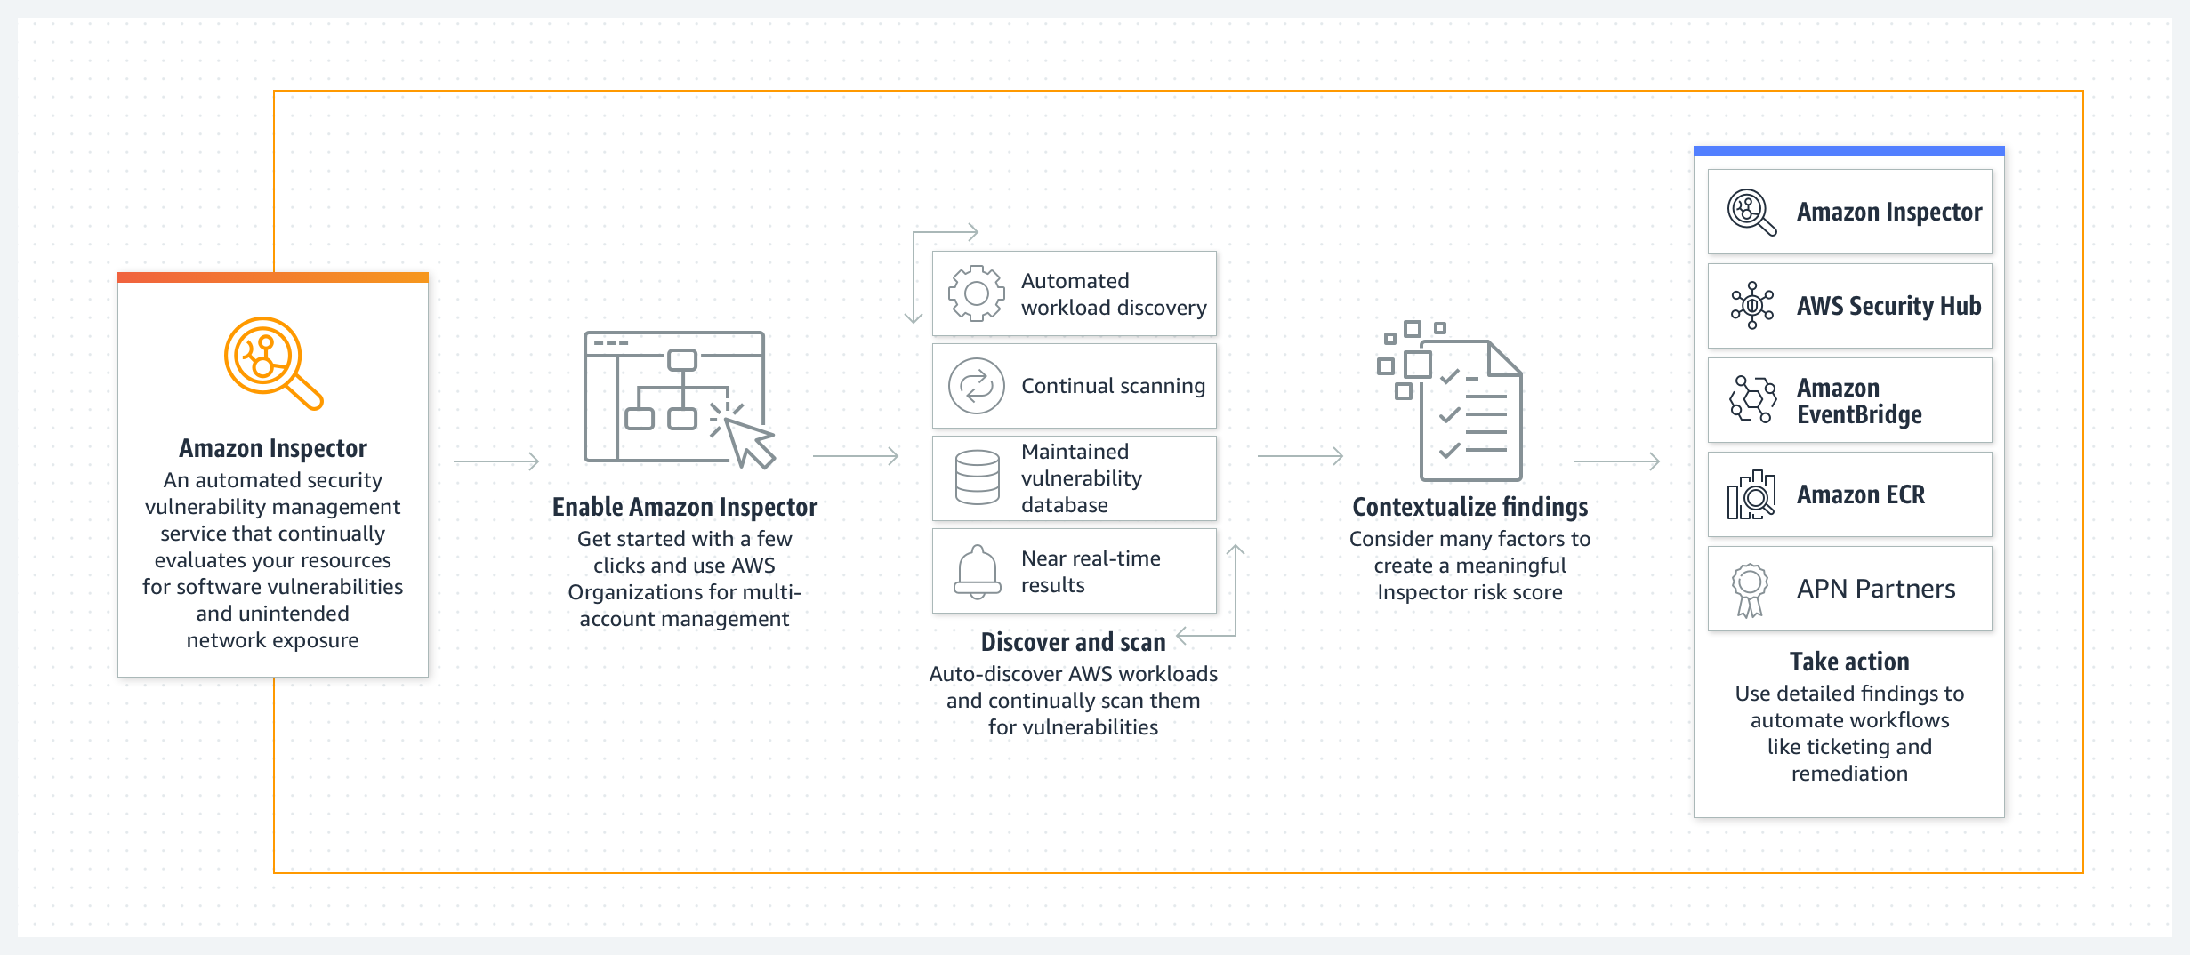
Cloud Native Tools Example
Source: https://aws.amazon.com/inspector

Slide 7
Financial Security Issues
The traditional "Denial of Service attack" is exploiting business solutions
Attackers exploit deficiencies to run up cloud costs
Examples:
Downloading the same file over and over (Egress Costs)
Finding long running processes and continuously triggering them (Compute Costs)

Slide 8
Financial Security Solutions
Two ways to combat
Business Solutions
Negotiate limits to the "pay-as-you-go" model
Example: commit to paying a certain amount of money for egress for "unlimited" data
Talk with account managers, they may be able to provide deals not publicly advertised!
Technical Solutions
Rate limit technical solutions
Set boundaries on serverless capabilities, eliminating the "unlimited"

Slide 9
Secure Configuration Management Issues
Misconfiguration of cloud settings is the leading cause of data breaches
Cloud environments can easily sprawl and become the "wild west"
Misconfiguration breaches:
Object storage exposed publicly which may contain sensitive data.
Publicly exposed ports and services that should be private

Slide 10
Secure Configuration Management Solutions
Develop cloud governance and organizational guidance
NIST Configuration Management control family
Use infrastructure as code (IaC) tools
Promotes configuration code reviews
Allows the usage of static code analyzers that can pick up on insecure configuration (TFSEC https://aquasecurity.github.io/tfsec)
Restrict access to cloud consoles – don't allow for the wild west

Slide 11
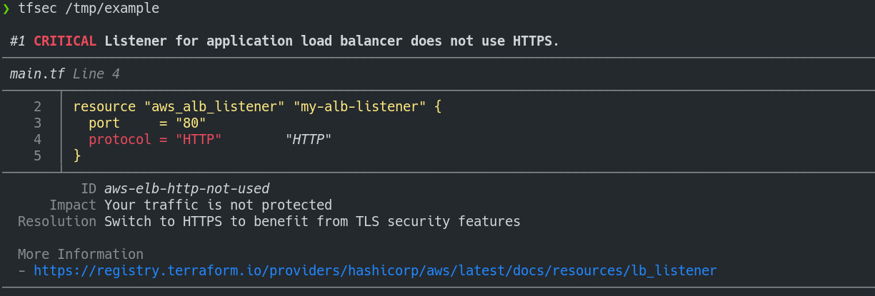
Secure Configuration Management Example
Source: https://github.com/aquasecurity/tfsec/blob/master/screenshot.png
Notes:
Explanation on how a tool such as TFSEC and defining configuration as code can identify gaps in security.

Slide 12
Future Considerations
Monitor cloud providers for new security offerings
Subscribe and follow CISA
https://www.cisa.gov/about/contact-us/subscribe-updates-cisa

Slide 13
Questions?
jacob.charles@bisoncloudsolutions.com
https://bisoncloudsolutions.com
https://www.linkedin.com/in/jacobcharles300/

